Slide 1


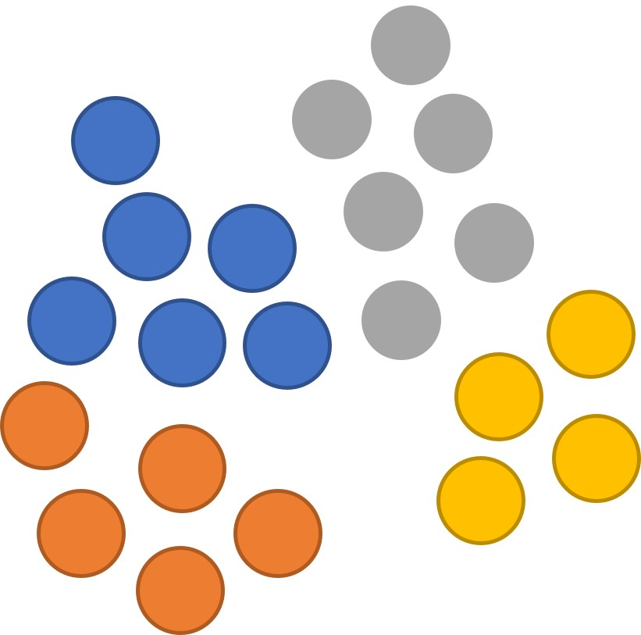



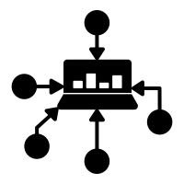







Interactions
scRNA-seq
Data collection
Analysis
Integration
TF binding
Comparative genomics
Validation
Human Protein Atlas
Text mining

